Slide 1
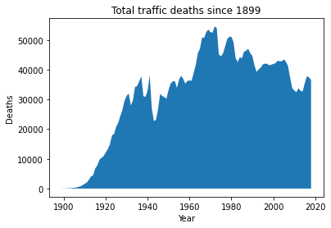
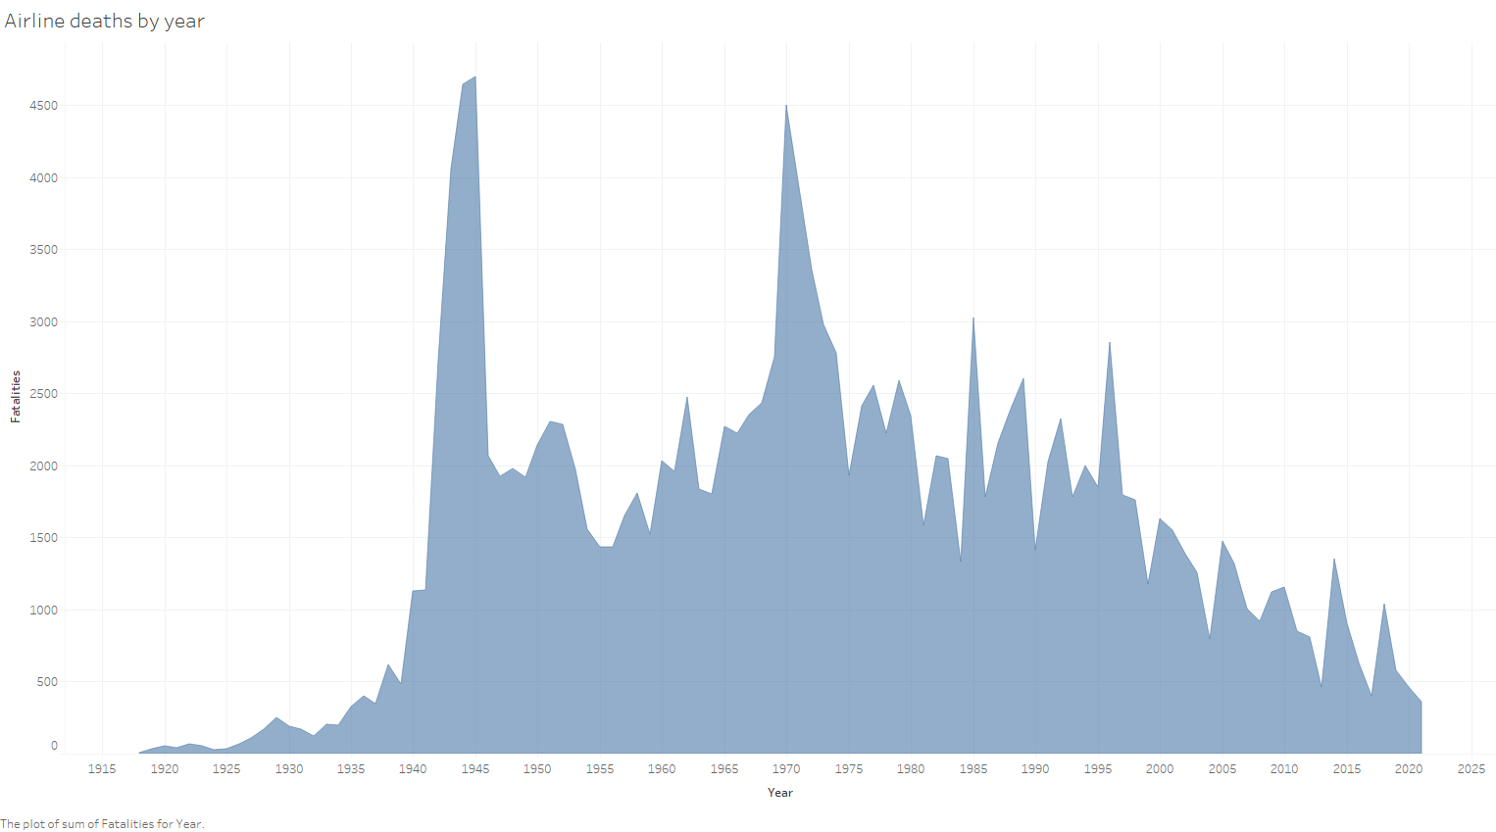
Airline deaths by year vs traffic

Slide 2
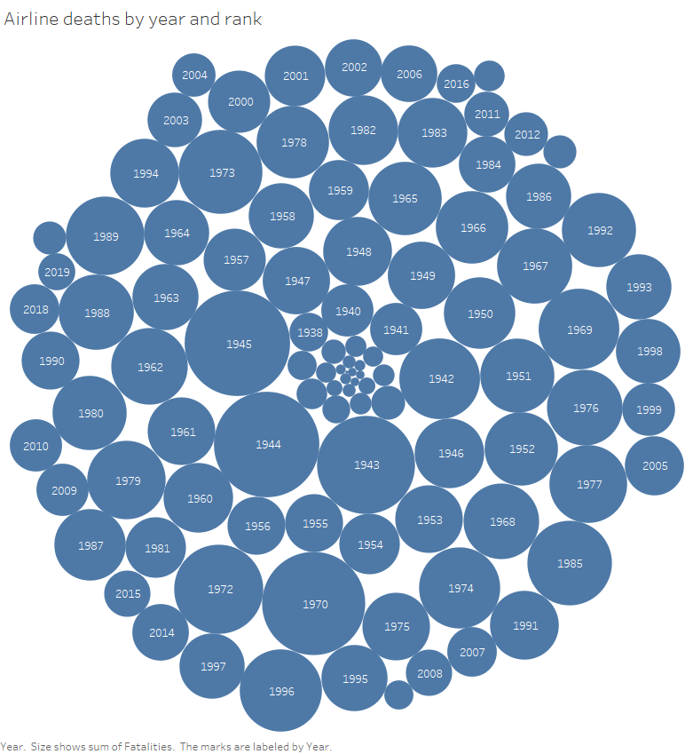
Recent years are smaller bubbles.

Slide 3
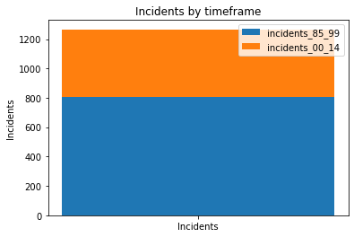
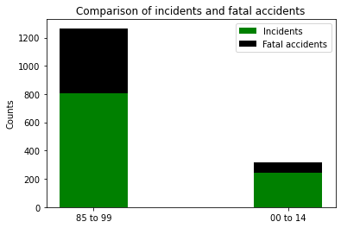
Fatal incidents and incidents are decreasing steadily.

Slide 4
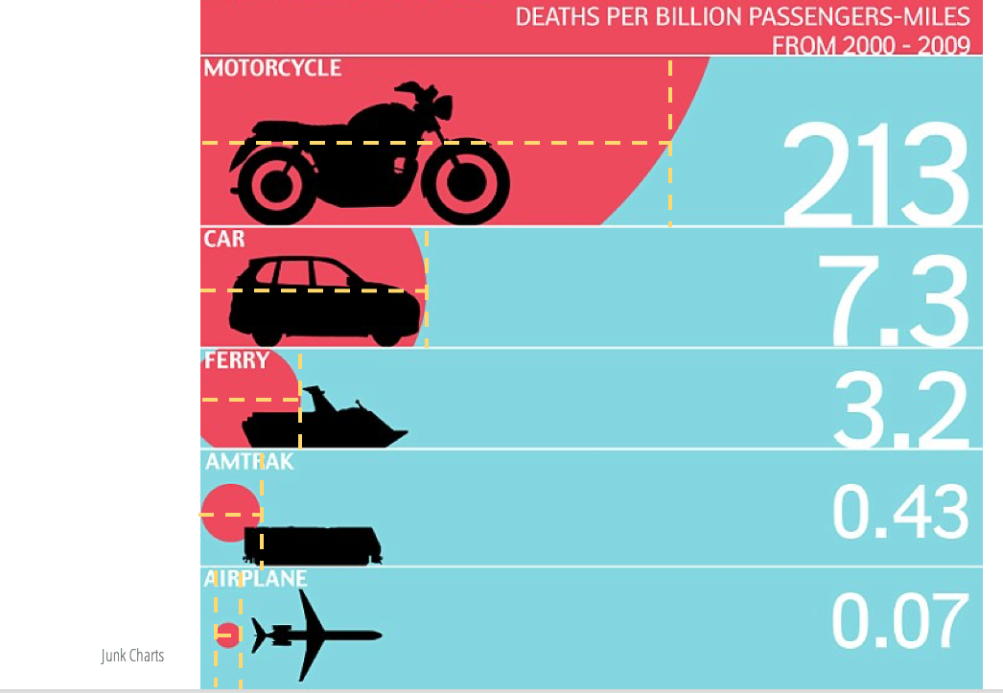
Does this convince you now that airlines are safest way to travel?

